Slide 1
MYSQL
Presented By Group 3
Bushra Yasmin
Akriti Ghosh
Pooja Sahu
Amber

Slide 2
About MYSQL
MySQL is an open-source Relational Database Management System (RDBMS). Its name is a combination of "My", the name of co-founder Michael Widenius's daughter and "SQL", the abbreviation for Structured Query Language.
MySQL is free and open-source software under the terms of the GNU General Public License, and is also available under a variety of proprietary licenses.
MySQL was owned and sponsored by the Swedish company MySQL AB, which was bought by Sun Microsystems (now Oracle Corporation).
MySQL is used by many database-driven web applications, including Drupal, Joomla, phpBB, and WordPress.

Slide 3
MySQL Commands
DDL
DML
DCL
TCL
CREATE
SELECT
COMMIT
ALTER
RENAME
DROP
UPDATE
TRUNCATE
INSERT
DELETE
GRANT
REVOKE
ROLLBACK
SAVEPOINT
CONSTRAINTS
NOT NULL
PRIMARY
FOREIGN
UNIQUE
DEFAULT

Slide 4
DDL: Create Schema
SYNTAX : -
CREATE {DATABASE | SCHEMA} [IF NOT EXISTS] db_name
[create_option] ...
create_option: {
[DEFAULT] CHARACTER SET [=] charset_name
| [DEFAULT] COLLATE [=] collation_name
| [DEFAULT] ENCRYPTION [=] {'Y' | 'N'}
}
CREATE DATABASE creates a database with the given name.
To use this statement, you need the CREATE privilege for the database.
CREATE SCHEMA is a synonym for CREATE DATABASE.

Slide 5
Data Definition Language
CREATE TABLE: To create a new table
CREATE TABLE table_name (column_name column_type, …);
DROP TABLE: It will delete the table, (record + structure) will be deleted
DROP TABLE table_name ;
UPDATE TABLE
UPDATE table_name SET field1 = new-value1, field2 = new-value2
[WHERE Clause];
ALTER TABLE:(we can change the structure)
SYNTAX : -
ALTER TABLE table_name COMMAND column_name datatype;
COMMANDS : -
ADD : Add a new column to the existing table
MODIFY : Change the data type or size
RENAME/CHANGE: we change the column name
DROP : we can drop the column

Slide 6
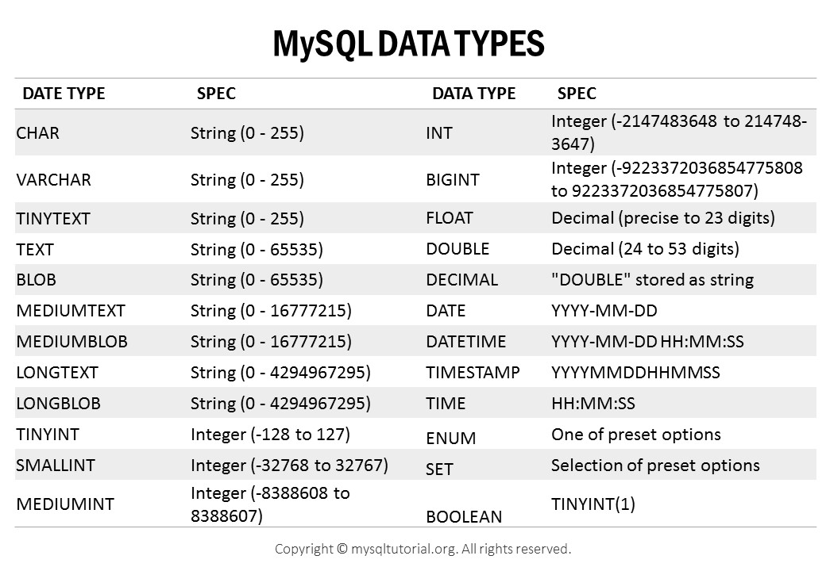

Slide 7
MYSQL CONSTRINTS
MySQL CONSTRAINT is used to define rules to allow or restrict what values can be stored in columns. The purpose of inducing constraints is to enforce the integrity of a database.
MySQL CONSTRAINTS can be classified into two types - column level and table level.
The column level constraints can apply only to one column where as table level constraints are applied to the entire table.
MySQL CONSTRAINT is declared at the time of creating a table.
MySQL CONSTRAINTS are :
NOT NULL
UNIQUE
PRIMARY KEY
FOREIGN KEY
CHECK
DEFAULT

Slide 8
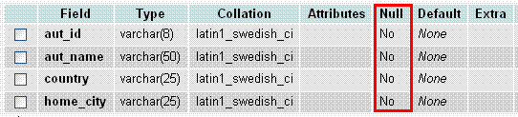
MYSQL CONSTRINTS
CREATE TABLE [table name]
([column name] [data type]([size]) [column constraint]….
[table constraint] ([[column name]……])……);
EXAMPLES: -
1) MySQL CREATE TABLE with NULL CONSTRAINT:
CREATE TABLE newauthor
(aut_id varchar(8) NOT NULL,
aut_name varchar(50) NOT NULL,
country varchar(25) NOT NULL,
home_city varchar(25) NOT NULL );

Slide 9
MYSQL CONSTRINTS
2) MySQL CREATE TABLE to check values with CHECK CONSTRAINT:
The following SQL creates a CHECK constraint on the "Age" column when the "Persons" table is created. The CHECK constraint ensures that the age of a person must be 18, or older:
CREATE TABLE Persons (
ID int NOT NULL,
LastName varchar(255) NOT NULL,
FirstName varchar(255),
Age int,
CHECK (Age>=18)
);

Slide 10
MYSQL CONSTRINTS
3) MySQL CREATE TABLE with PRIMARY CONSTRAINT:
CREATE TABLE roles(
role_id INT AUTO_INCREMENT,
role_name VARCHAR(50),
PRIMARY KEY(role_id)
);
4) MySQL CREATE TABLE with FOREIGN CONSTRAINT:
CREATE TABLE Orders (
OrderID int NOT NULL,
OrderNumber int NOT NULL,
PersonID int,
PRIMARY KEY (OrderID),
FOREIGN KEY (PersonID) REFERENCES Persons(PersonID)
);

Slide 11
MYSQL CONSTRINTS
5) MySQL CREATE TABLE with DEFAULT CONSTRAINT:
CREATE TABLE Persons (
ID int NOT NULL,
LastName varchar(255) NOT NULL,
FirstName varchar(255),
Age int,
City varchar(255) DEFAULT 'Sandnes'
);
6) DROP ANY CONSTRAINTS IN MYSQL:
ALTER TABLE tble_name
DROP Constraints_name;

Slide 12
SELECT command
Select command is used for selecting rows from a table.
Select is the most used DML command
Select command returns a result set of records from one or more tables
A SELECT statement can consist up to six clauses but only SELECT and FROM clauses are mandatory
SYNTAX:
SELECT [DISTINCT | ALL]
{* | [column_expression [AS
new_name]] [,...] }
FROM table_name [alias] [, ...]
[WHERE condition]
[GROUP BY column_list]
[HAVING condition]
[ORDER By column_list]

Slide 13
VIEW
VIEW is a virtual table based on the result set of an SQL statement.
A VIEW contains rows and columns just like a real table.
There are three types of operations can be possible on view.
CREATE VIEW
REPLACE VIEW
DROP VIEW

Slide 14
PATTERN MATCHING
SQL has two special pattern matching SYMBOLS:
%: sequence of zero or more characters;
_ (underscore): any single character.
LIKE '%dd%' means a sequence of characters of any length containing ‘dd'.

Slide 15
ALIASING
A table alias is created by directly placing an alias after the table name in the FROM clause.
The advantage of using a table alias when performing JOIN is readily apparent when we discuss JOIN later.
Example : departments table as d or dept.
SELECT d.dname
FROM departments d
WHERE d.dno = 1;
SELECT dept.dname
FROM departments dept
WHERE dept.dno = 1;

Slide 16
SET OPERATIONS
The SQL Set operation is used to combine the two or more SQL SELECT statements.
Types of Set operation
1. Union
2. UnionAll
3. Intersect
4. Minus

Slide 17
UNION OPERATOR
This operator is used to combine two similar queries results into one single result.
Here both the queries should have same number of columns and all the respective columns should be of same data types.
The order of columns in both the queries should also be same.
This operator eliminates the duplicate records and displays single record.
The resultant records are sorted in ascending order by default.

Slide 18
UNION ALL OPERATOR
Union All operation is equal to the Union operation.
It returns the set without removing duplication and sorting the data
SYNTAX
SELECT Column_name FROM table1
UNION ALL
SELECT Column_name FROM table2;
EXAMPLE
SELECT * FROM First
UNION ALL
SELECT * FROM Second;

Slide 19
INTERSECTION OPERATOR
Operator compares the result of two queries and returns the distinct rows that are output by both queries
Here both the queries should have same number of columns and all the respective columns should be of same datatypes.
SYNTAX
SELECT column_name From Table1
INTERSECT
SELECT column_name From Table2

Slide 20
MINUS OPERATOR
This operator is used to display the records that are present only in the first table or query, and doesn’t present in second table / query.
It basically subtracts the first query results from the second.
SYNTAX
SELECT Column_list1,Column_list2 From Table1
MINUS
SELECT Column_lis1,Column_list2 From Table2

Slide 21
Arithmetic Operators in SQL
Arithmetic operators ( +, -, /, *) can be applied to numeric values or attributes with numeric domain.
It can be used in expressions in the SELECT and the WHERE clauses to compute numeric values.
All attributes that can be computed using arithmetic expressions (such as age from birth date, annual salary from monthly salary) must be eliminated as part of a good design practice in databases.

Slide 22
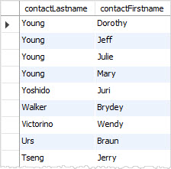
ORDER BY
The ORDER BY keyword is used to sort the result-set in ascending or descending order.
The ORDER BY keyword sorts the records in ascending order by default or by using ASC keyword.
To sort the records in descending order, use the DESC keyword.
SYNTAX:
SELECT select_list
FROM table_name
ORDER BY
column1 [ASC|DESC],
column2 [ASC|DESC], ...;

Slide 23
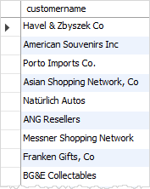
IN KEYWORD
The WHERE clause when used together with the IN keyword only affects the rows whose values matches the list of values provided in the IN keyword.
IN helps reduces number of OR clauses you may have to use
If a subquery returns more than one value, you can use other operators such as IN or NOT IN operator in the WHERE clause.
EXAMPLE
Display customer names who have placed orders
SELECT customerName
FROM customers
WHERE customerNumber IN
(SELECT DISTINCT customerNumber FROM orders);

Slide 24
ALL KEYWORD
The ALL operator compares value to every value returned by the subquery.
Therefore ALL operator (which must follow a comparison operator) returns TRUE if the comparison is TRUE for ALL of the values in the column that the subquery returns.
NOT IN is an alias for <> ALL.
SELECT c1 FROM t1
WHERE c1 <> ALL (SELECT c1 FROM t2);
SELECT c1 FROM t1
WHERE c1 NOT IN (SELECT c1 FROM t2);
EXAMPLE
List the product names if ALL the records in the OrderDetails table has quantity = 10
SELECT ProductName
FROM Products
WHERE ProductID = ALL
(SELECT ProductID
FROM OrderDetails
WHERE Quantity = 10);

Slide 25
ANY KEYWORD
The ANY keyword, which must follow a comparison operator, means “return TRUE if the comparison is TRUE for ANY of the values in the column that the subquery returns.
SYNTAX
SELECT column_name(s)
FROM table_name
WHERE column_name operator ANY
(SELECT column_name
FROM table_name WHERE condition);
EXAMPLE:
List the product names if it is ordered in quantity = 10: -
SELECT ProductName
FROM Products
WHERE ProductID = ANY
(SELECT ProductID
FROM OrderDetails
WHERE Quantity = 10);

Slide 26
SOME KEYWORD
The word SOME is an alias for ANY.
Thus, these two statements are the same:
SELECT c1 FROM t1 WHERE c1 <> ANY (SELECT c1 FROM t2);
SELECT c1 FROM t1 WHERE c1 <> SOME (SELECT c1 FROM t2);
Use of the word SOME is rare.
The syntax means “there is some b to which a is not equal.”
Using <> SOME instead helps ensure that everyone understands the true meaning of the query.

Slide 27
EXIST/NOT EXIST KEYWORD
EXAMPLE:
What kind of store is present in one or more cities?
SELECT DISTINCT store_type
FROM stores
WHERE EXISTS
(SELECT * FROM cities_stores
WHERE
cities_stores.store_type = stores.store_type);
The EXISTS operator tests for the existence of rows in the results set of the subquery.
If a subquery row value is found, EXISTS subquery is TRUE and in this case NOT EXISTS subquery is FALSE.
When a subquery is used with the EXISTS or NOT EXISTS operator, a subquery returns a Boolean value of TRUE or FALSE.
SYNTAX:
SELECT column1 FROM table1
WHERE EXISTS (SELECT * FROM table2);

Slide 28
AGGREGATE FUNCTION
Aggregate function | Description
AVG() | Return the average of non-NULL values.
BIT_AND() | Return bitwise AND.
BIT_OR() | Return bitwise OR.
BIT_XOR() | Return bitwise XOR.
COUNT() | Return the number of rows in a group, including rows with NULL values.
GROUP_CONCAT() | Return a concatenated string.
JSON_ARRAYAGG() | Return result set as a single JSON array.
JSON_OBJECTAGG() | Return result set as a single JSON object.
MAX() | Return the highest value (maximum) in a set of non-NULL values.
MIN() | Return the lowest value (minimum) in a set of non-NULL values.
STDEV() | Return the population standard deviation.
STDDEV_POP() | Return the population standard deviation.
STDDEV_SAMP() | Return the sample standard deviation.
SUM() | Return the summation of all non-NULL values a set.
VAR_POP() | Return the population standard variance.
VARP_SAM() | Return the sample variance.
VARIANCE() | Return the population standard variance.
Aggregate Functions are all about
Performing calculations on multiple rows
Of a single column of a table
And returning a single value.
The ISO standard defines five aggregate functions namely:
COUNT
SUM
AVG
MIN
MAX
SYNTAX:
SELECT FUNCTION(column_name) FROM table;

Slide 29
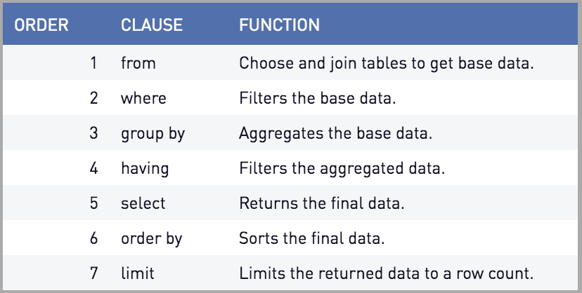
Order of QUERY Execution

Slide 30
GROUP BY & HAVING Clause
SELECT column1, function_name(column2)
FROM table_name
WHERE condition GROUP BY column1,column2
ORDER BY column1, column2;
E.g, : -
Group By single column | Group By multiple columns
SELECT Subject, Count(*) FROM Subject_Selection GROUP BY Subject; | SELECT column1, function_name(column2) FROM table_name WHERE condition GROUP BY column1, column2 HAVING condition ORDER BY column1, column2;

Slide 31
WITH clause
SYNTAX:
WITH temporaryTable as
(SELECT Attr1 FROM Table);
Mutliple WITH clauses SYNTAX:
WITH tempTable1 as (query1),
tempTable2 AS (query2);
EXAMPLE:
WITH employee AS
(SELECT * FROM Employees)
SELECT * FROM employee
WHERE ID < 20
UNION ALL SELECT * FROM employee
WHERE Sex = 'M’

Slide 32
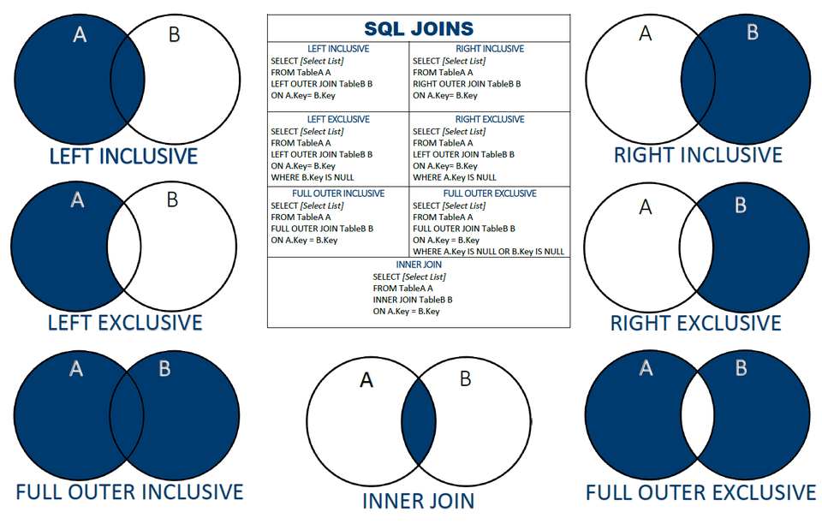
Join

Slide 33
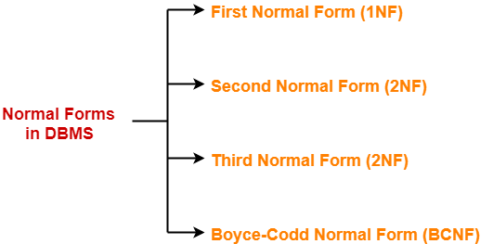
Normalization
1NF: It must be single value.
2NF: 1NF and fully functional dependency
3NF: 2NF and X→ Y
X is super key,
Y is prime attribute
BCNF: X → Y
X is super key of R

Slide 34

Group 3

